Slide 1
Deep Learning Based Collaborative Filtering
Bhavya Patel (bsp75), Paul Kanyuch (pwk29),
Abhigya Sinha (as3883)

Slide 2
Our Model
- Deep Learning-Based collaborative filtering neural network with embedding layers
- Attention mechanism for explainability
- Interactive web interface
- Comprehensive metrics suite
- Visualization tools

Slide 3
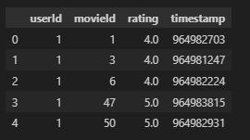
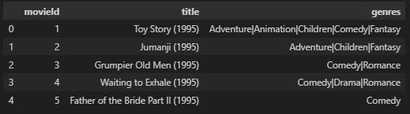
Our Dataset
Dataset Name: Movielens-Small
100,000 ratings provided by 610 users across 9,724 movies.
Explicit feedback in the form of user ratings on a scale from 1 to 5.
Characteristics:
Sparsity: Most users rate only a small fraction of available movies, creating a sparse user-item interaction matrix.
Class Imbalance: Due to sparsity, ratings are often biased towards positive feedback, as users tend to rate more movies they like rather than dislike.
Preprocessing Steps:
User and movie IDs are encoded as integers using label encoding.
The dataset is split into 80% training and 20% validation sets, maintaining temporal order.

Slide 4
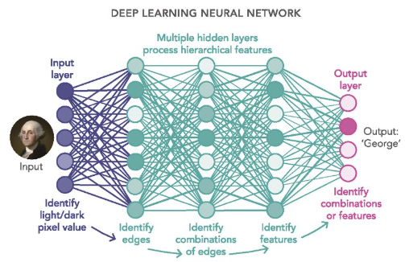
Model Architecture
Input Representation:
User IDs and Movie IDs are mapped to dense 128-dimensional embeddings.
Embedding layers learn latent features for users and movies.
Embedding Concatenation - Combines user and movie embeddings into a single feature vector.
Hierarchical Neural Network:
Fully connected layers with progressive dimensionality reduction:
512 → 256 → 128 → 64 neurons.
ReLU activation captures non-linear relationships.
Regularization:
Batch normalization stabilizes training by mitigating internal covariate shifts.
Graduated dropout prevents overfitting (0.3 → 0.2 → 0.1).
Output Layer: Single neuron with Sigmoid activation, scaled to a 1-5 system to match database ratings.

Slide 5
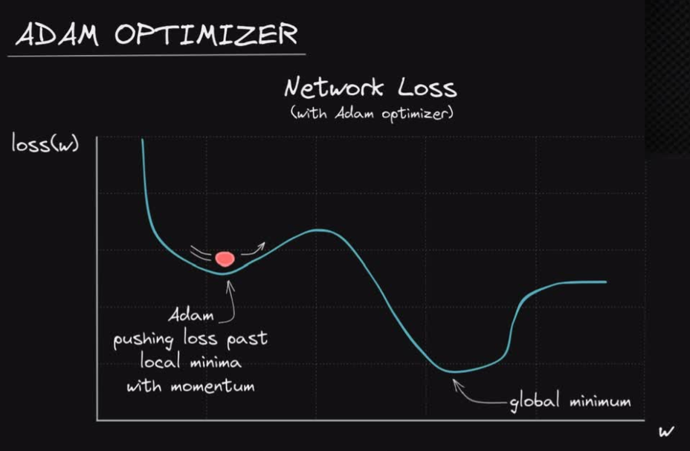
Optimization Strategies
Xavier Initialization:
Ensures balanced weight initialization across layers and prevents scales from diminishing/amplifying.
Prevents vanishing or exploding gradients, facilitating stable training.
Designed to handle deep networks by sustaining even gradient propagation.
Adam optimizer
Combines the benefits of momentum and adaptive learning rates for efficient convergence.
Automatically adjusts learning rates for individual parameters based on their gradients.
Utilizes 1st and 2nd moment estimates of gradients for updates.
Integrated with a learning rate scheduler to reduce the rate when validation loss plateaus, preventing overfitting to the training data.

Slide 6
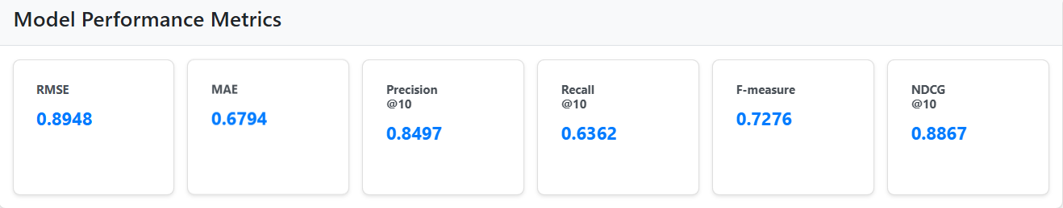
Evaluation Metrics for Sample Run
RMSE: 0.8968 (indicating strong predictive accuracy).
Mean Absolute Error (MAE): 0.6870
Precision@10: 0.8497 (measuring relevance of top recommendations).
Recall@10: 0.6362 (capturing the proportion of relevant items retrieved).
F-measure: 0.7276 (balancing precision and recall).
NDCG@10: 0.8851 (demonstrating effective ranking performance for top recommendations).

Slide 7
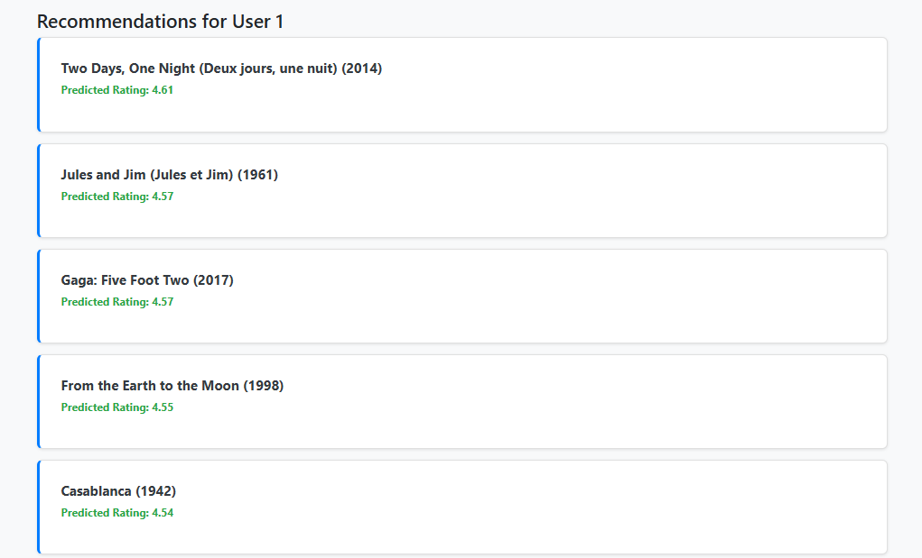
Top 5 Recommendations for UserID 1

Slide 8
Bonus: Explainability
Uses an attention-based mechanism to provide transparency in how recommendations are generated, with a recommendation strength scored between 0 and 1.
Two key factors: user preferences and movie characteristics
Attention weights always total 1
User preferences weight shows how much the recommendation relies on the user's rating history, while the movie characteristics weight indicates the contribution of the movie's inherent features.
A high-confidence recommendation (0.9) might have different weightings, such as 0.65 for user preferences and 0.35 for movie characteristics.
This approach enhances system trust by making the recommendation process transparent, allowing users to understand the rationale behind specific movie suggestions.

Slide 9
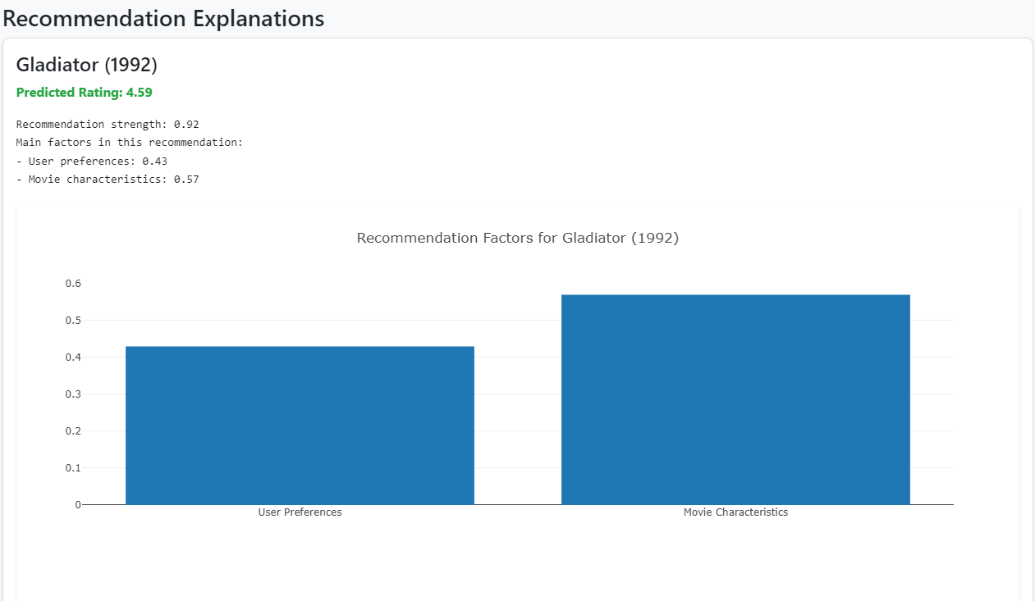
Bonus: Explainability for User 2

Slide 10
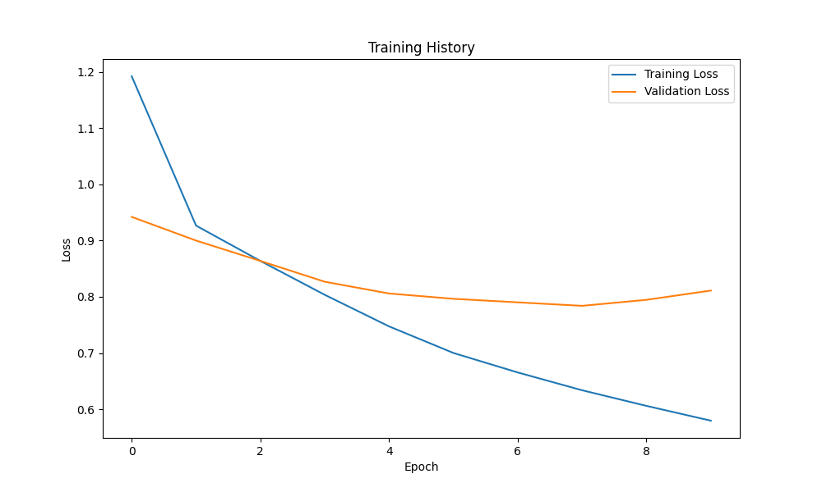
Training Process

Slide 11
Conclusion
Utilized a deep-learning based collaborative filtering system and neural network architectures with dual embedding layers and regularization techniques
Experimental results on MovieLens dataset showed superior performance:
RMSE (0.8968), Precision@10 (0.8497), Recall@10 (0.6362), and NDCG@10(0.8870)
Hierarchical neural architectures enabled nuanced capture of user-item interactions through progressive dimensionality reduction; graduated dropout and batch normalization provide robust regularization
3 promising future research directions: (1) contextual personalization, (2) multimodal learning, and (3) adaptive learning frameworks

